Slide 1
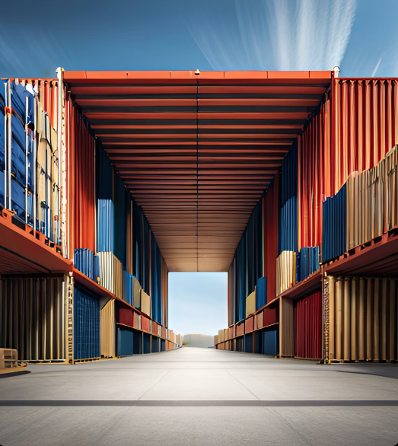
Optimizing Logistics:
Solving the
0/1 Knapsack
Problem

Slide 2

Introduction to the 0/1 Knapsack Problem
The 0/1 knapsack problem is a classic optimization problem in computer science and mathematics. The problem involves selecting a subset of items, each with a weight and value, to maximize the total value while staying within a given weight limit.
This problem has numerous real-world applications, such as optimizing cargo loading on a ship or truck, maximizing profits in investment portfolios, and determining which products to stock in a store.

Slide 3

1. Approximate method for the KP:
The code implements a greedy algorithm for solving the knapsack problem. It takes a list of values, a list of weights, and the capacity of the knapsack as inputs. It calculates the value-to-weight ratio for each item, sorts the items in descending order of their ratio, and iterates over the sorted items. It adds items to the knapsack as long as adding the item does not exceed the capacity. The code returns the maximum value obtained and the indices of the included items. The example usage demonstrates how to use the function with specific values and weights, and calculates the optimal solution, maximum value, and quality percentage.

Slide 4
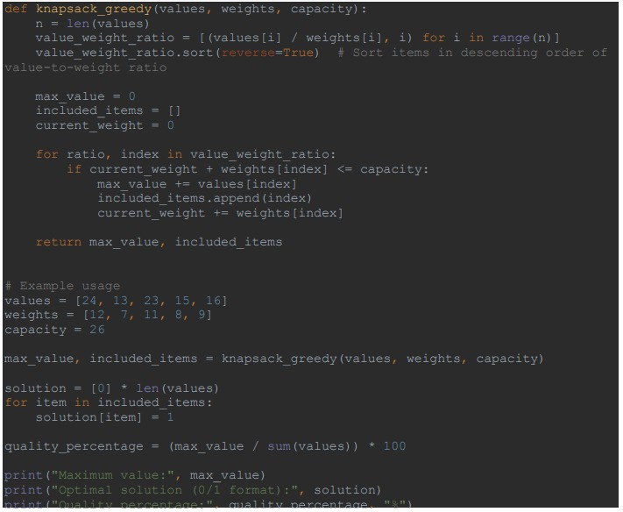
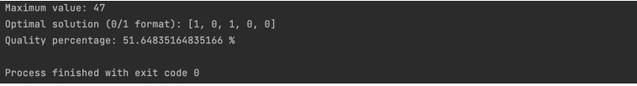
Code&Output
For
Approximate algorithm

Slide 5
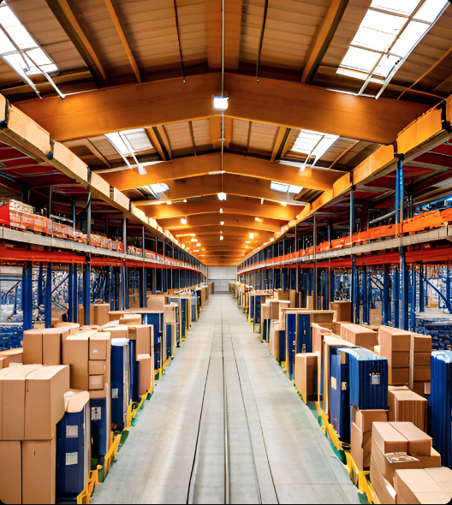
2. Exact method for the KP :
The code uses a genetic algorithm to solve the 0-1 Knapsack Problem. It generates a random population of solutions, evaluates their fitness, and evolves them through multiple generations. The best solution found is returned as the output. The algorithm uses crossover and mutation operations to explore the search space. The fitness of each solution is calculated based on the total value of the selected items, considering the knapsack's weight capacity. The code also includes predefined values, weights, and capacity for the knapsack problem instance. The best solution and its fitness are printed, along with the quality percentage of the solution.

Slide 6
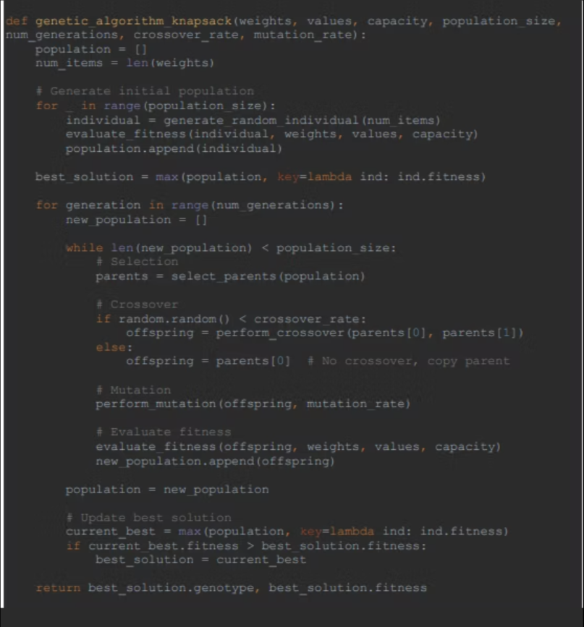
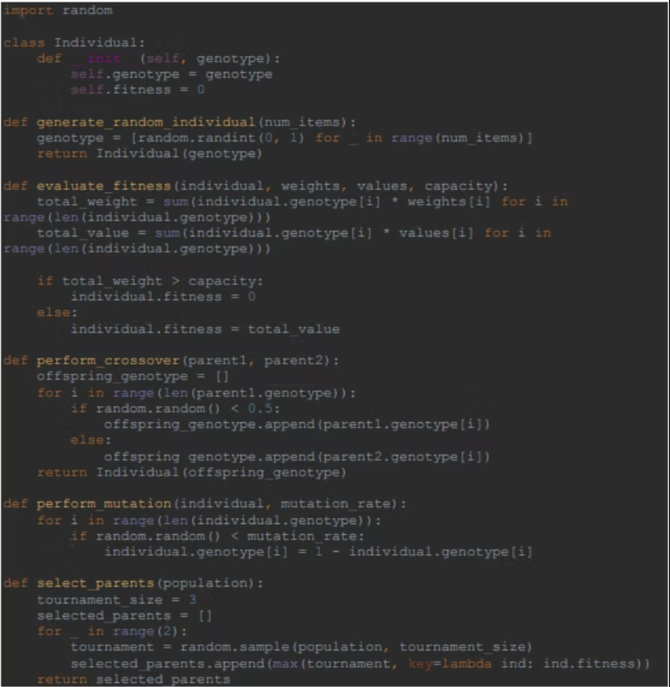

Slide 7
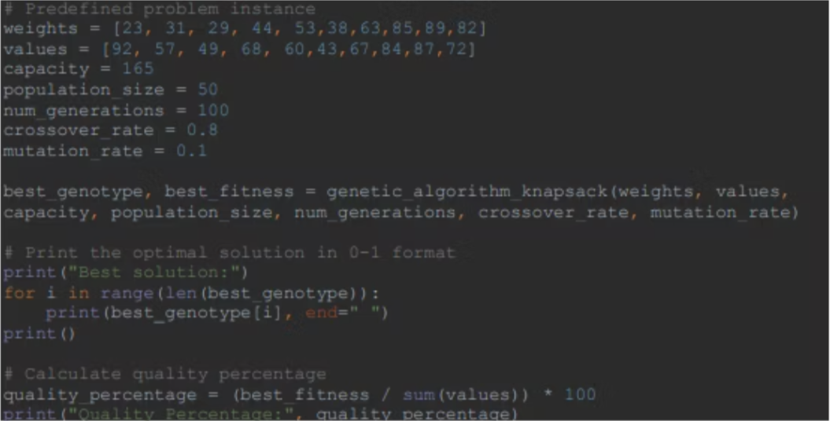

Slide 8
3. Comparison of the obtained results & 4. Instances (8 instances) and details.
Exact algorithm | Approximate algorithm | Instance
45.51% | 45.51% | 1
56.04% | 51.65% | 2
56.60% | 55.09% | 3
56.91% | 54.25% | 4
68.80% | 65.59% | 5
45.68% | 38.91% | 6
52.90% | 52.29% | 7
53.47% | 51.77% | 8

Slide 9

STUDENT NAME: KHALID NIMRI STUDENT ID: 2140145 STUDENT NAME: ASEEL SUHAIL STUDENT ID: 2140197

